Slide 1


Slide 2

JSP:
JSP: JSP architecture
Life Cycle
Creating Simple JSP Page
JSP Basic tags
Implicit Objects.
JDBC:
Introduction to JDB
JDBC architecture
JDBC Drivers
Database Connectivity
CRUD operations.

Slide 3
Introduction to JSP

Slide 4
JSP
  JSP stands for Java Server Pages
  JSP is used explicitly for creating dynamic web applications
  Pages created using JSP are simpler to manage as compared to a Servlet
  JSP pages are the reciprocal of Servlets as a servlet incorporates HTML code within Java code
  whereas JSP includes Java code within HTML with the help of JSP tags.

Slide 5
JSP
JSP is Server-side scripting language: means that the JSP code is processed on the web server rather than the client machine.
JSP page is a file saved with a .jsp extension that contains the combination of HTML Tags and JSP codes.
JSP is an improved extended version of Servlet technology

Slide 6
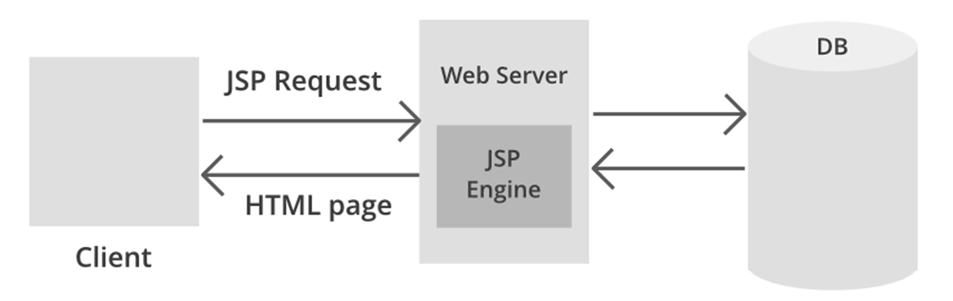
JSP Architecture

Slide 7
JSP
JSP architecture gives a high-level view of the working of JSP.
JSP architecture is a 3 tier architecture.
It has a Client, Web Server, and Database.
The client is the web browser or application on the user side.
Web Server uses a JSP Engine i.e; a container that processes JSP.
For example, Apache Tomcat has a built-in JSP Engine.
JSP Engine intercepts the request for JSP and provides the runtime environment for the understanding and processing of JSP files.
It reads, parses, build Java Servlet, Compiles and Executes Java code, and returns the HTML page to the client.
The webserver has access to the Database.

Slide 8
Advantages of JSP over Servlets:
Servlets are difficult to code which are overcome in JSP. Other way, we can say, JSP is almost a replacement of Servlets, where coding decreases more than half.
In Servlets, both static code and dynamic code are put together. In JSP, they are separated. For example, In Servlets:
  out.println(“Hello Mr.” + str + ” you are great man”);
  where str is the name of the client which changes for each client and is known as dynamic content.
  In JSP:
  Hello Mr. // static content as HTML code
  <%= str %> // dynamic content as JSP code
JSP needs no compilation, CLASSPATH setting and packaging.
JSP have nine implicit objects. i.e., JSP, Programmer never creates these objects and straightaway use them as they are implicitly created and given by JSP container. This decreases lot of coding.
JSP needs no compilation by the Programmer.
No need to configure the jsp in web.xml.
Whenever JSP modified, modifications reflected without recompilation, where as in Servlet without compilation not possible to reflect the modification.

Slide 9
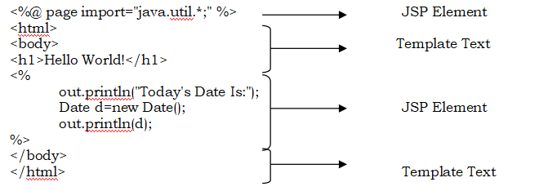
Anatomy of JSP page:
JSP element: Business logic , written withinin <%----%>
Template text: In the JSP page that is not a JSP element is called template text . Template text can really be any text: HTML, WML, XML, or even plain text.

Slide 10
JSP processing/Life Cycle Methods:
JSP Processing is done in 2 phases:
Translation Phase
Request Processing Phase
Translation Phase: A JSP container is responsible for converting the JSP page into a servlet (known as the JSP page implementation class) and compiling the servlet. These two steps form the translation phase.
  Translation
  Compilation
  Loading
  Instantiation
  Initialization
Request Processing Phase:
The JSP container is also responsible for invoking the JSP page implementation class to process each request and generate the response. This is called the request processing phase.

Slide 11
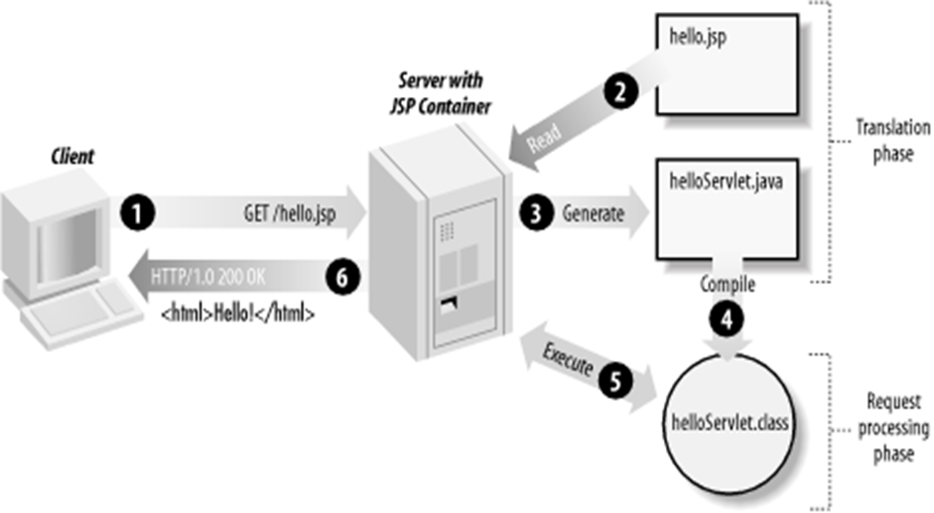

Slide 12
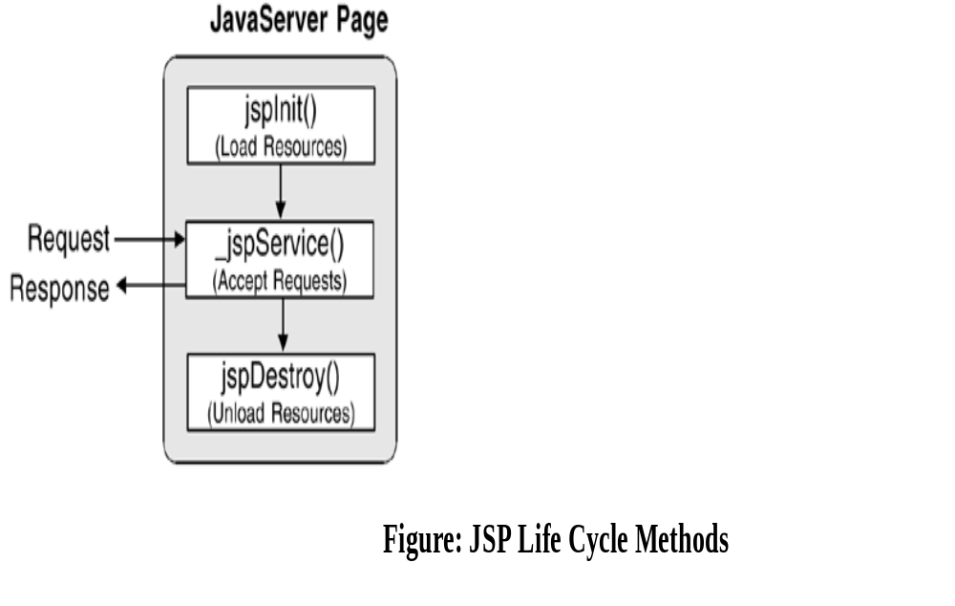
JSP Life Cycle methods

Slide 13
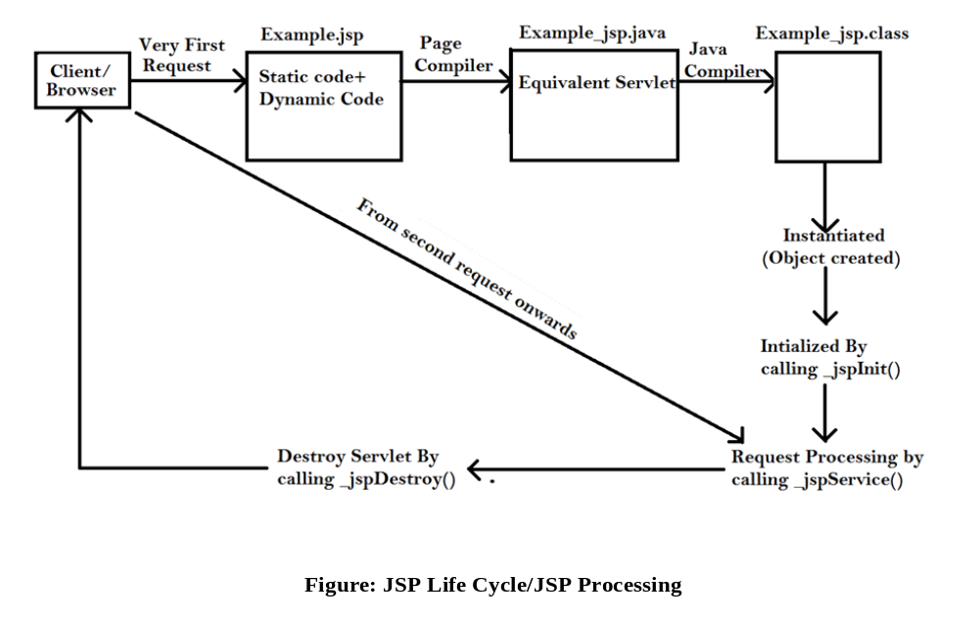

Slide 14
JSP ELEMENTS:
There are three types of elements with Java
Server Pages:
1. Directive
2. Action
3. Scripting Elements.
(Additional Elements are JSP Implicit Objects)

Slide 15
Directive
These tags are used to provide specific instructions to the web container when the page is translated.
It has three subcategories:
  Page: <%@ page ... %>
  Include: <%@ include ... %>
  Taglib: <%@ taglib ... %>

Slide 16
Syntax of the page directive
<%@ page attribute = "attribute_value" %>
Eg:
<%@ page import=“java.sql.*”%>
<%@ page language=“java”%>
<%@ page errorpage=“url”%>
<%@ page iserrorpage=“true”%>
<%@ page session=“true”%>

Slide 17
Include directive
It is used to include one file in another JSP file.
This includes HTML, JSP, text, and other files.
Syntax:
  <%@ include file = "relative url" >
Eg:
<%@ include file=“one.jsp" %>

Slide 18
taglib directive
It is implemented to define a tag library with "taglib" as its prefix.
Custom tag sections of JSP use taglib.
JSP's taglibdirective is used as standard tag libraries.
Syntax:
<%@ taglib uri="uri" prefix="value"%>
Eg:
<%@ taglib uri = "http://www.example.com/custlib"%>

Slide 19
JSP ACTION TAG
JSP Action Tags | Description
jsp:forward | forwards the request and response to another resource.
jsp:include | includes another resource.
jsp:useBean | creates or locates bean object.
jsp:setProperty | sets the value of property in bean object.
jsp:getProperty | prints the value of property of the bean.
jsp:plugin | embeds another components such as applet.
jsp:param | sets the parameter value. It is used in forward and include mostly.
jsp:fallback | can be used to print the message if plugin is working. It is used in jsp:plugin.

Slide 20
Scripting Elements
Scripting elements in JSP must be written within the <% %> tags.
  Comment <%-- comment statements --%>
  Directive <%@ directive %>
  Declaration <%! declarations %>
    Eg: <%! int a = 540; %>
  Scriptlet <% scriplets %>
      Eg: <% int count = count+1; %>
  Expression <%= expression %>
      Eg: <%= “Welcome to JSP" %>

Slide 21
JDBC
JDBC refers to the Java Database Connectivity
It provides java API that allows Java programs to access database management systems (relational database).

Slide 22
JDBC core components
JDBC Drivers
Connections
Statements
ResultSets

Slide 23
JDBC Drivers
It is a collection of classes which implements interfaces defined in the JDBC API for opening database connections, interacting with database and closing database connections.

Slide 24
Connections
Before performing any database operation via JDBC, we have to open a database connection.
To open a database connection we can call getConnection() method of DriverManager class.
Syntax:
Connection connection = DriverManager.getConnection(url, user, password)

Slide 25
Statements
The JDBC statements are used to execute the SQL or PL/SQL queries against the database.
We need a statement for every single query.
JDBC API defines the Statement, CallableStatement, and PreparedStatement types of statements.

Slide 26
ResultSets
A query returns the data in the form of ResultSet.
To read the query result date ResultSet provides a cursor that points to the current row in the result set.

